Slide 1

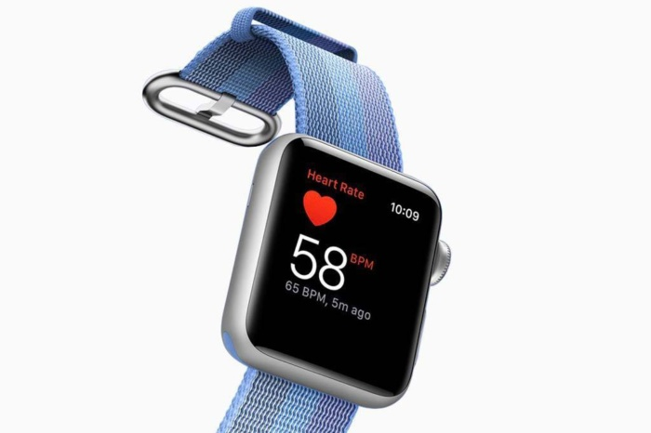

SMART BLOOD PRESSURE MONITORING SYSTEM
2015510013 Gül Eda Aydemir ----- 2014510034 Mazlum Eryılmaz

Slide 2
THE PROBLEM
WHAT IS HYPERTENSION?
CURRENT SYSTEM
THE SOLUTION
FUTURE SYSTEM
FUUUUTURE SYSTEM
HEALTH SYSTEMS & TECHNOLOGY
FRONT – END SIDE
HTML
CSS
JAVASCRIPT
BACK – END SIDE
ASP.NET- N-TIER ARCHITECTURE
MSSQL
PROJECT TOPIC
TECHNOLOGIES

Slide 3
THE PROBLEM

Slide 4
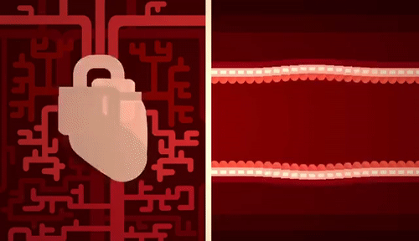
WHAT IS HYPERTENSION ?

Slide 5
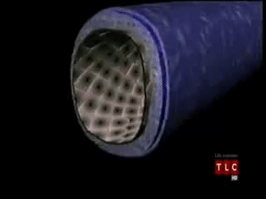
WHAT IS HYPERTENSION ?
CAUSES
Heart Failure And Heart Attacks
An Aneurysm, Or An Abnormal Bulge In The Wall Of An Artery That Can Burst, Causing Severe Bleeding
Kidney Failure
Stroke
Amputation
Blindness
Death

Slide 6
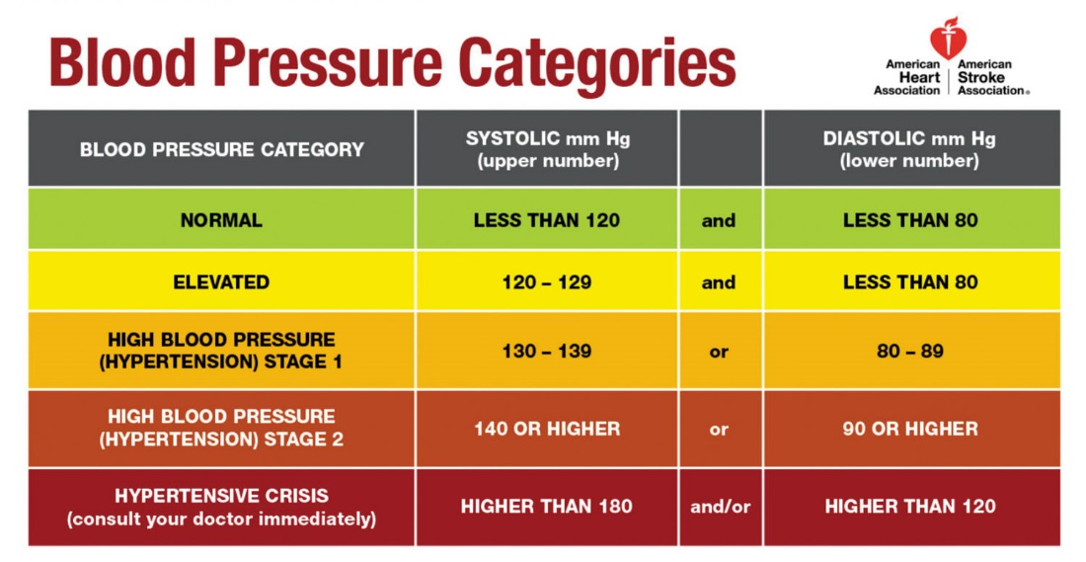
WHAT IS HYPERTENSION ?

Slide 7
CURRENT SYSTEM

Slide 8
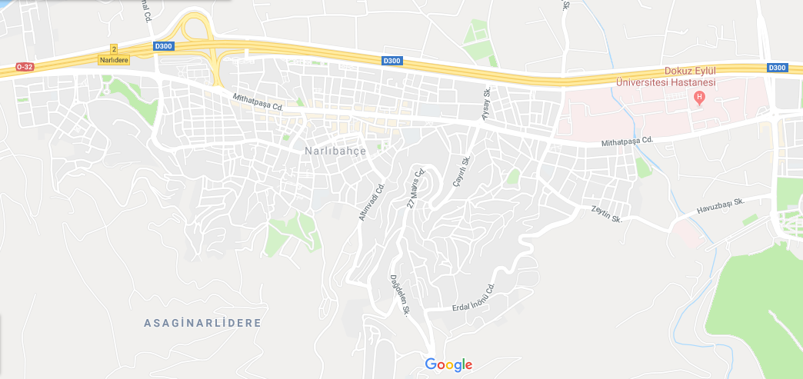









Slide 9

Measure Three Times A Day.
Ok.

Slide 11
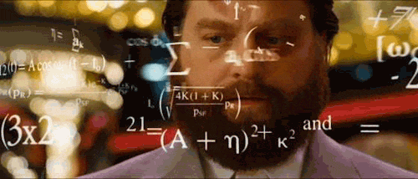
3 meas. = data / daily
3 * 30 = 90 data / monthly

Slide 12
Problem: Regular Treatment is hard.
Goal: Regular Treatment -> More Blood Pressure Data
THE SOLUTION

Slide 13
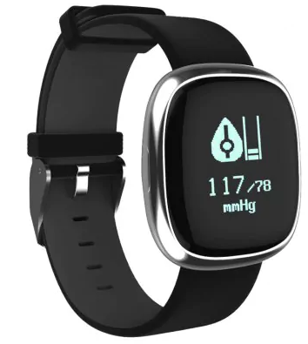
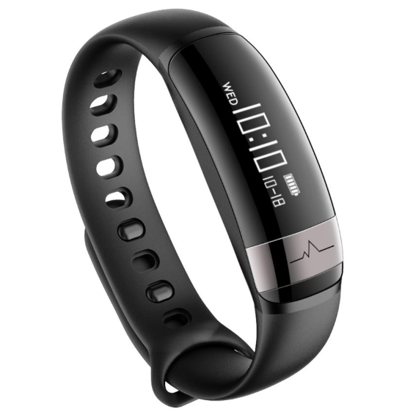
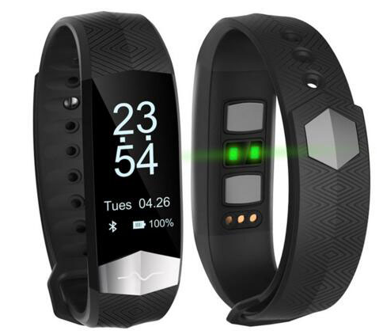
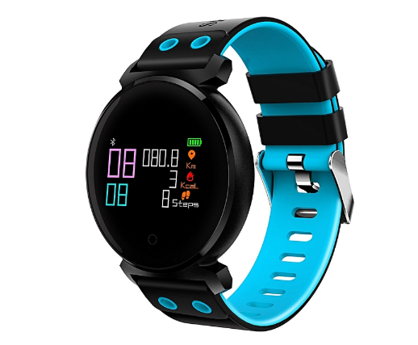
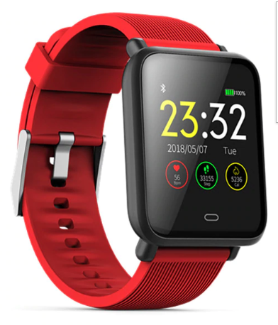
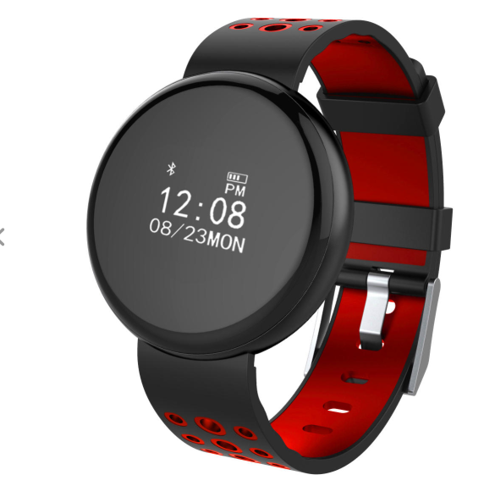
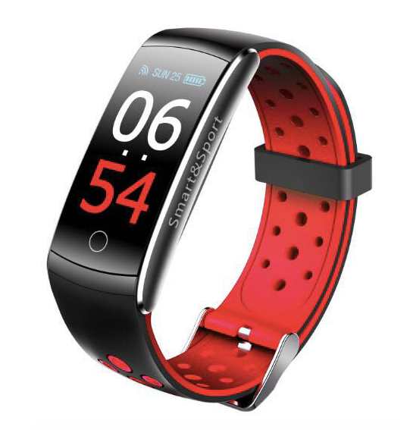
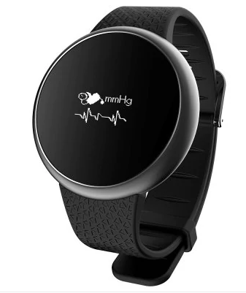
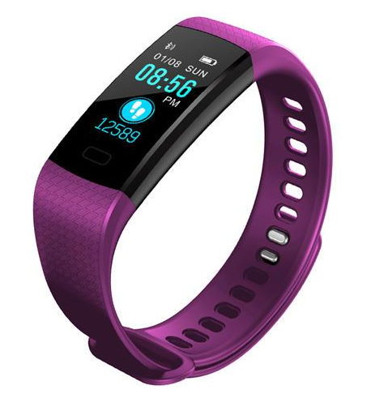
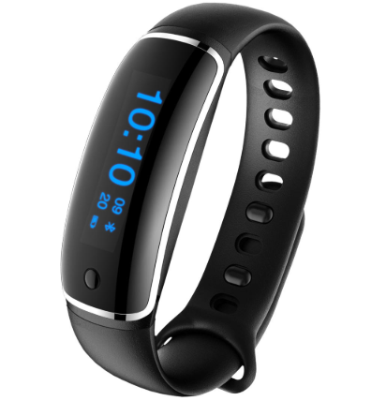
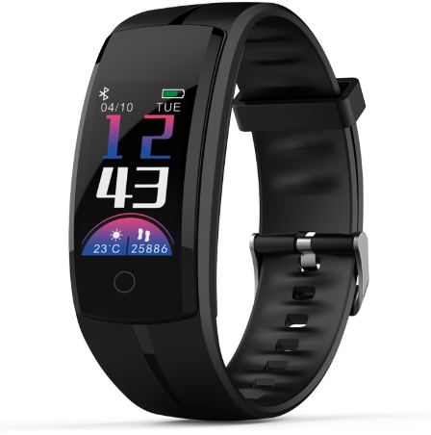
SMART WATCHES
Blood Pressure
Step Counter
Oxygen Level
Sleep Hours
Heart Rate
Notification

Slide 14
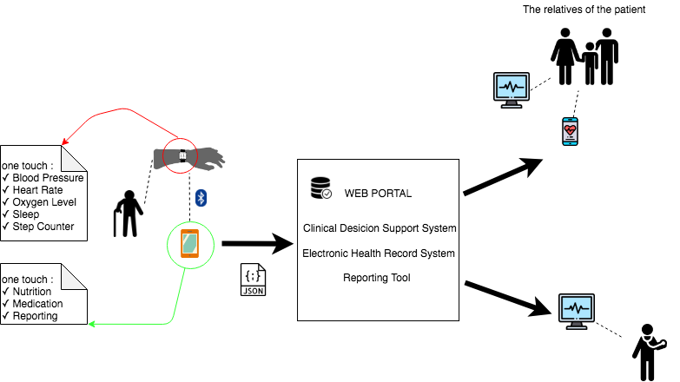

THE SOLUTION

Slide 15
10 meas. in 1 min = 600 data /hour
600*24 = 14400 data / daily
14400 * 30 = 432000 data/ monthly

Slide 16
14400 * 30 = 432000 data/ monthly
≈ 14.31 Gigabytes data/ monthly

Slide 17
TECHNOLOGY

Slide 18
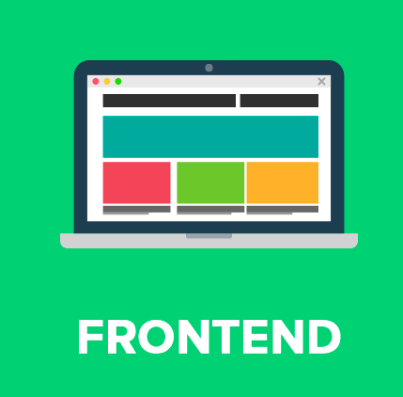
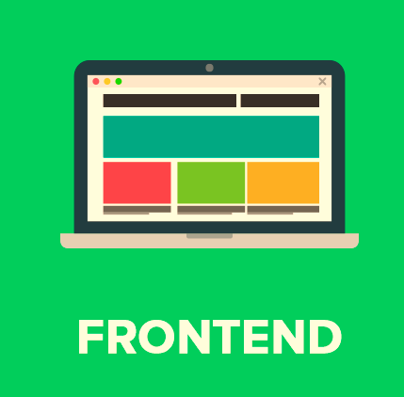




TECHNOLOGIES
Which technologies have we used?
HTML
CSS
JAVASCRIPT
BOOTSTRAP

Slide 19
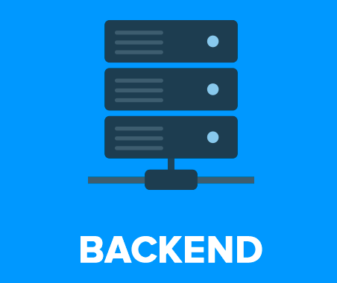
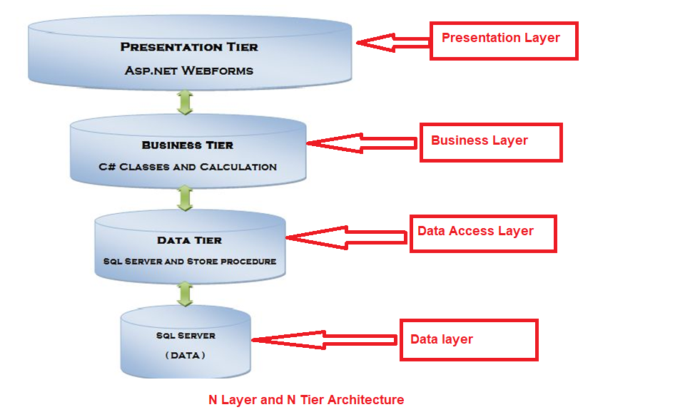

TECHNOLOGIES
Which technologies have we used?
ASP.NET
N-TIER ARCHITECTURE

Slide 20
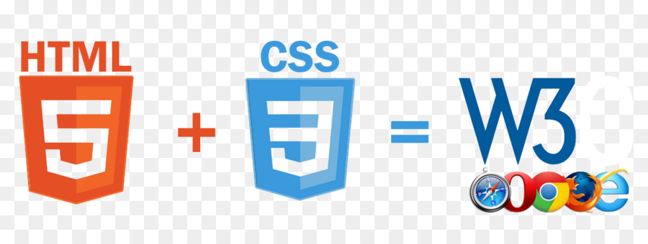
FRONT-END TECHNOLOGIES
WHY HTML & CSS have been used?
HTML
Easy to learn and use.
It is by default in every windows so you don't need to use another software.
Its plain text so it’s easy to edit
CSS
CSS helps establish a consistent framework that Web designers can use across all the sites they build. (Consistency)
CSS works with Internet Explorer, Firefox, Chrome and more.( Multiple Browser Support)
It provides you attractive look to your web pages
It help to separates the document content

Slide 21
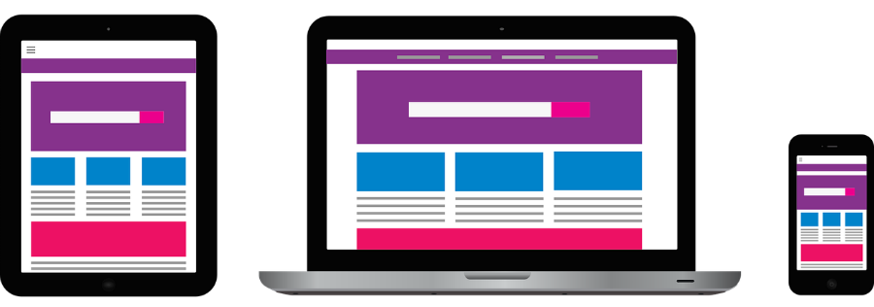
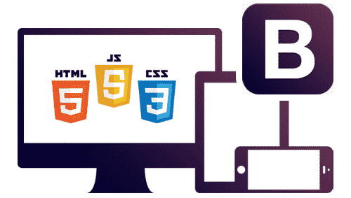
FRONT-END TECHNOLOGIES
Why Bootstrap?
Great grid system: Bootstrap is built on responsive 12-column grids, layouts and components. Whether you need a fixed
grid or a responsive, its only matter of a few changes. Offsetting & Nesting of columns is also possible
in both fixed and fluid width layouts.
Extensive list of components: Whether you need drop down menus, pagination or alert boxes, Bootstrap has got your
covered. Styling of every single element follows a consistent theme and if you know LESS, then customizing it takes
just few minutes.
Some of the components pre styled are:
Dropdowns
Button Groups
Navigation Bar
Breadcrumbs
Labels & Badges
Alerts
Progress Bar
And many others.

Slide 22
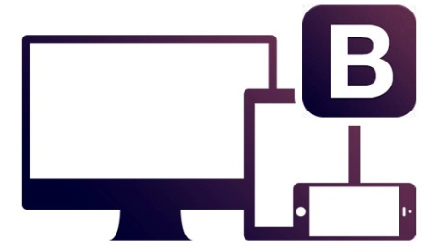
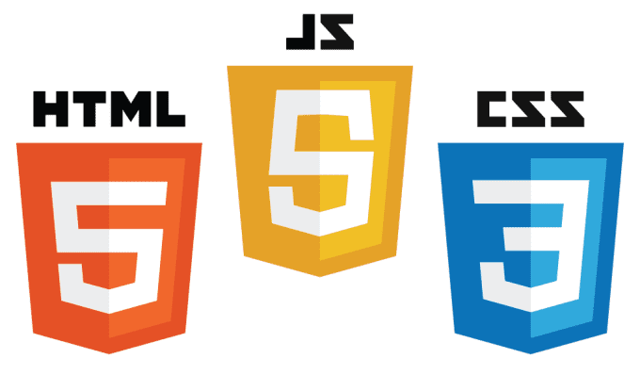
FRONT-END TECHNOLOGIES
In a nutshell,
HTML: It describes how elements on a website should be laid out and provides browsers with a list of all the other files,
like CSS and JavaScript, that websites need. You can think of HTML like the blueprint of a house.
It tells you how big the rooms are and what should be inside them. But it doesn't tell you how they should look.
CSS: If HTML describes the layout of a house, CSS describes the look of a house.
JavaScript: Of the big three web languages, JavaScript is the only one that's considered an actual programming language.
JavaScript controls interactions on a website.
Responsive design: Open a website and make your browser smaller. Did the page content change its layout to fit the new screen? That’s responsive design. People expect modern websites to look great on their phones and on their laptops.
Notes:
HTML: HTML is the first of the big three languages you need to learn to make websites—HTML, CSS and JavaScript. HTML isn't a programming language per se. It describes how elements on a website should be laid out and provides browsers with a list of all the other files, like CSS and JavaScript, that websites need. You can think of HTML like the blueprint of a house. It tells you how big the rooms are and what should be inside them. But it doesn't tell you how they should look.
CSS:If HTML describes the layout of a house, CSS describes the look of a house. CSS, or Cascading Style Sheets, is responsible for the way websites look. Colors, fonts, and even some animations are all controlled by CSS. Like HTML, CSS isn't a programming language. It's a text document that reads like an interior designer's instructions for making a website look great.
JavaScript:Of the big three web languages, JavaScript is the only one that's considered an actual programming language. JavaScript controls interactions on a website. It's like a handyman that can tear down walls, build new rooms and redecorate your house. For a simple, static website, you won't need to use much JavaScript. But for a dynamic web app you'll need an in-depth understanding of the language

Slide 23
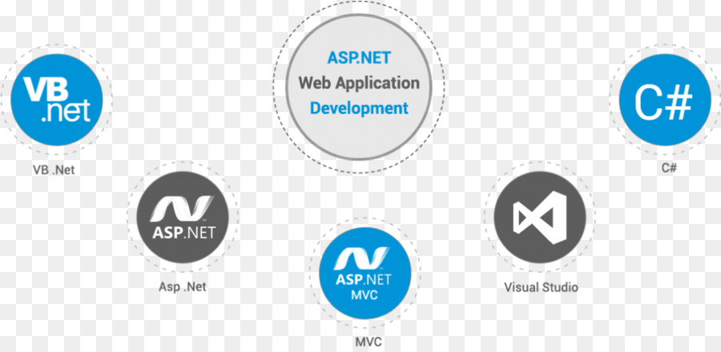
BACK-END TECHNOLOGIES
WHY ASP.NET ?
The ASP code and HTML smoothly mix with each other to generate dynamic web pages.
This technology is purely server-side, the code has the ability to execute on the server. This
is good because it actually executes before it’s actually sent to the browser.
It allows for separation of concern: This n-tier architecture, has interconnected parts, and
can handle specific development aspects of software applications.

Slide 24
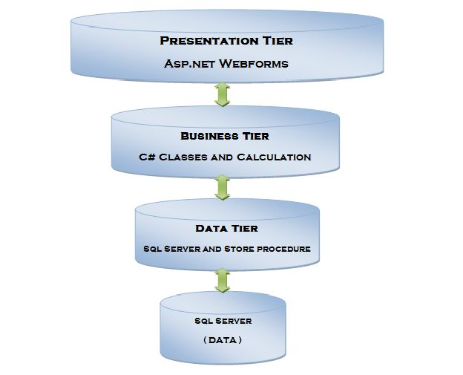
BACK-END TECHNOLOGIES
WHY N-TIER ARCHITECTURE ?
Better and finer security control to the whole system.
Independent tier upgrading and changing without affecting other tiers.
More efficient development.
Easy to reuse.
Easy to manage.
Notes:
we can enforce the security differently for each tier if the security requirement is different for each tier. For example, business tier and data tier usually need higher security level than presentation tier does, then we can put these two high security tiers behind firewall for protection.
in object-oriented world, Interface-dependency implementation can decouples all layers very well so that each layer can change Individually without affecting other layers too much.
N-tier architecture is very friendly for development, as different teams may work on each tier. This way, you can be sure the design and presentation professionals work on the presentation tier and the database experts work on the data tier.
Because the application is divided into independent tiers, you can easily reuse each tier for other software projects. For instance, if you want to use the same program, but for a different data set, you can just replicate the logic and presentation tiers and then create a new data tier.
You can manage each tier separately, adding or modifying each tier without
affecting the other tiers

Slide 25

BACK-END TECHNOLOGIES
PHP has not used. WHY?
Security: Since it is open sourced, so all people can see the source code, if there are bugs in the source code of web-site development, it can be used by people to explore the weakness of PHP.
PHP Framework has a Bad Error Handling Method: This is not the proper solution for PHP Developers, so it is a problem with the PHP Developer.
We have never experinced using PHP.

Slide 26

WEB SERVICES
Google Map: The Google Maps Platform web services are a collection of HTTP interfaces to Google services providing geographic data for your maps applications.

Slide 27
SIMILAR APPLICATIONS
A Dynamic Web Application within an n-tier Architecture: a Multi-Source
Information System for End-Stage Renal Disease

Slide 28
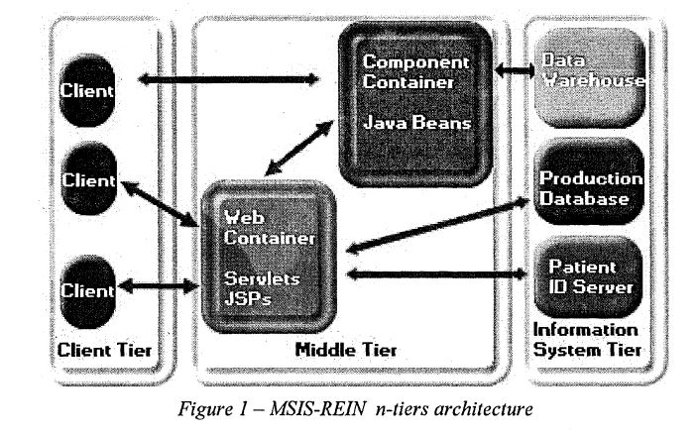
SIMILAR APPLICATIONS
An n-tier architecture has been chosen at the network level. It is made out of a universal client, a dynamic Web server
connected to a production database and to a data warehouse.

Slide 29
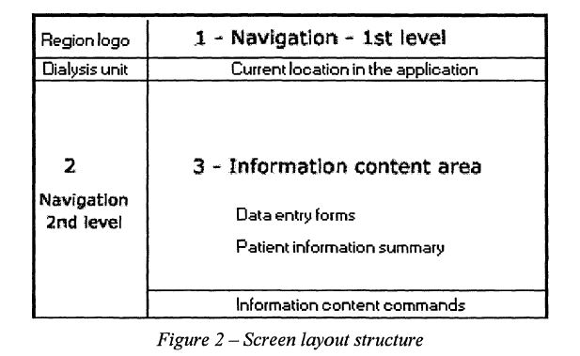
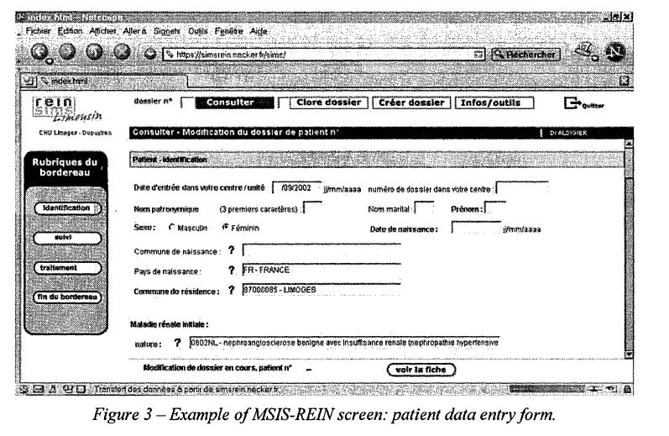
SIMILAR APPLICATIONS
Screen layout design and user interface;

Slide 30


Slide 31
REFERENCES
https://www.health.harvard.edu/heart-health/reading-the-new-blood-pressure-guidelines
https://giphy.com/search/blood-pressure
https://giphy.com/search/math
https://www.ncbi.nlm.nih.gov/m/pubmd/14663969

Slide 32
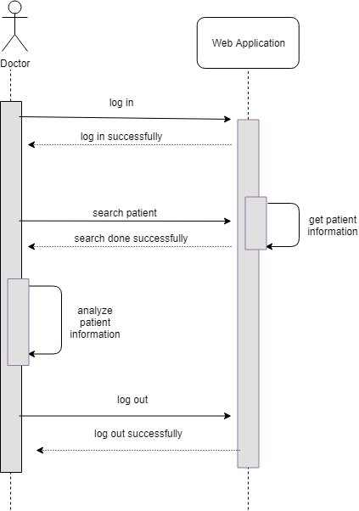

Slide 33
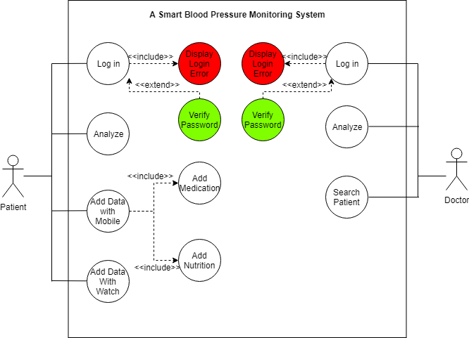
Patient → Mobile , Doctor → Web Application

Slide 34
TC NO
PASSWORD
Login
Sign up
Login

Slide 35
ADI
SOYADI
TC NO
PASSWORD
REPASSWORD
Login
Sign up
Sign up

Slide 36
ÇIKIS
AYARLAR
HASTA ARA
400|
ARA
10

Slide 37
ÇIKIS
AYARLAR
HASTA ARA
400|
ARA
RAPOR ÇIKAR
10
Hasta Bilgileri
Hasta Nerede
Hasta Mesaj
NABIZ
KAN BASINCI
O2LEVEL
UYKU
ADIM
BESIN
İLAÇLAR

